Slide 1


IoT Fundamentals
A Practical Session on Building an Air Quality IoT Network
Engineer Bainomugisha
Department of Computer Science, Makerere University, Uganda
baino@cis.mak.ac.ug

Slide 2
Objective
to build an IoT node/network and develop simple data analytics & visualisations

Slide 3
What we will cover
Introduction to IoT
Building an IoT node for air quality monitoring
data analysis and visualisation of IoT collected data

Slide 4
Session Materials
http://airqo.net/dsa

Slide 5
What is IoT?

Slide 6
What is IoT?
“a network of devices "things” embedded in the physical environment”

Slide 7

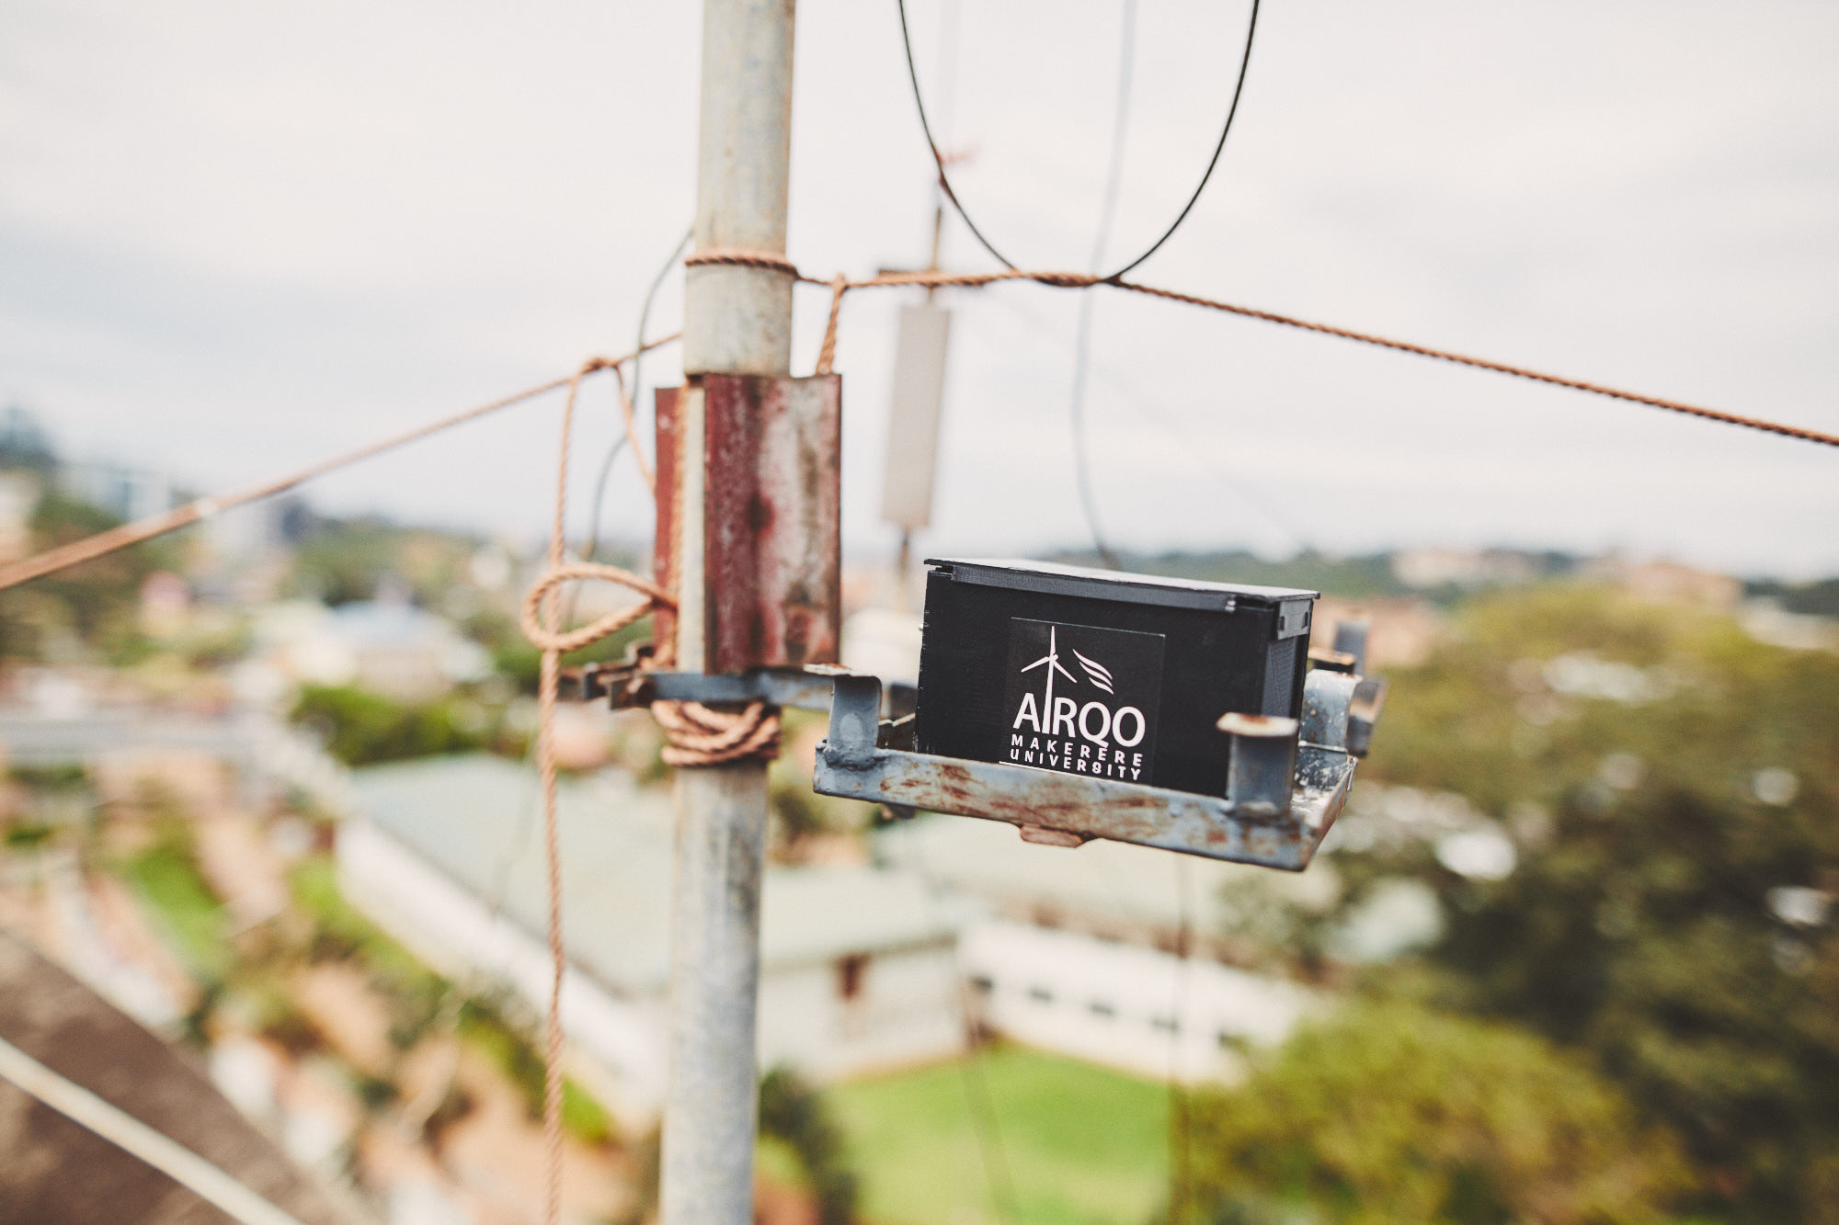
IoT for air quality monitoring

Slide 8
Why air quality matters?
Notes:
Why air quality matters?

Slide 9
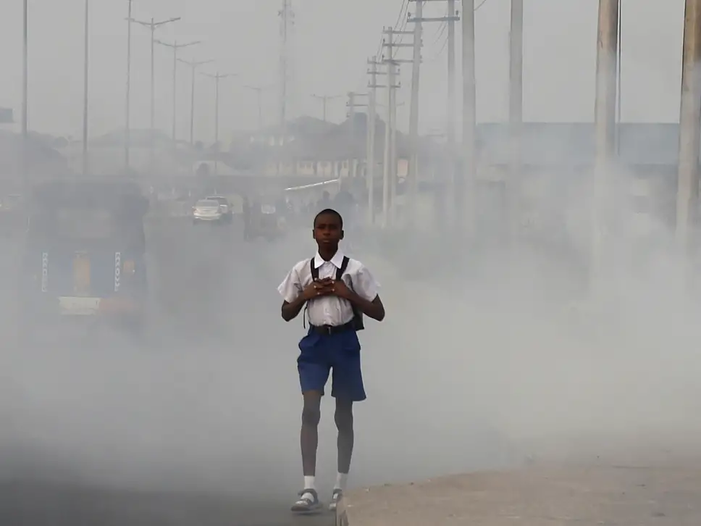

Air pollution effects
9 out 10
people breathe polluted air
7 million deaths
every year
Internet source

Slide 10
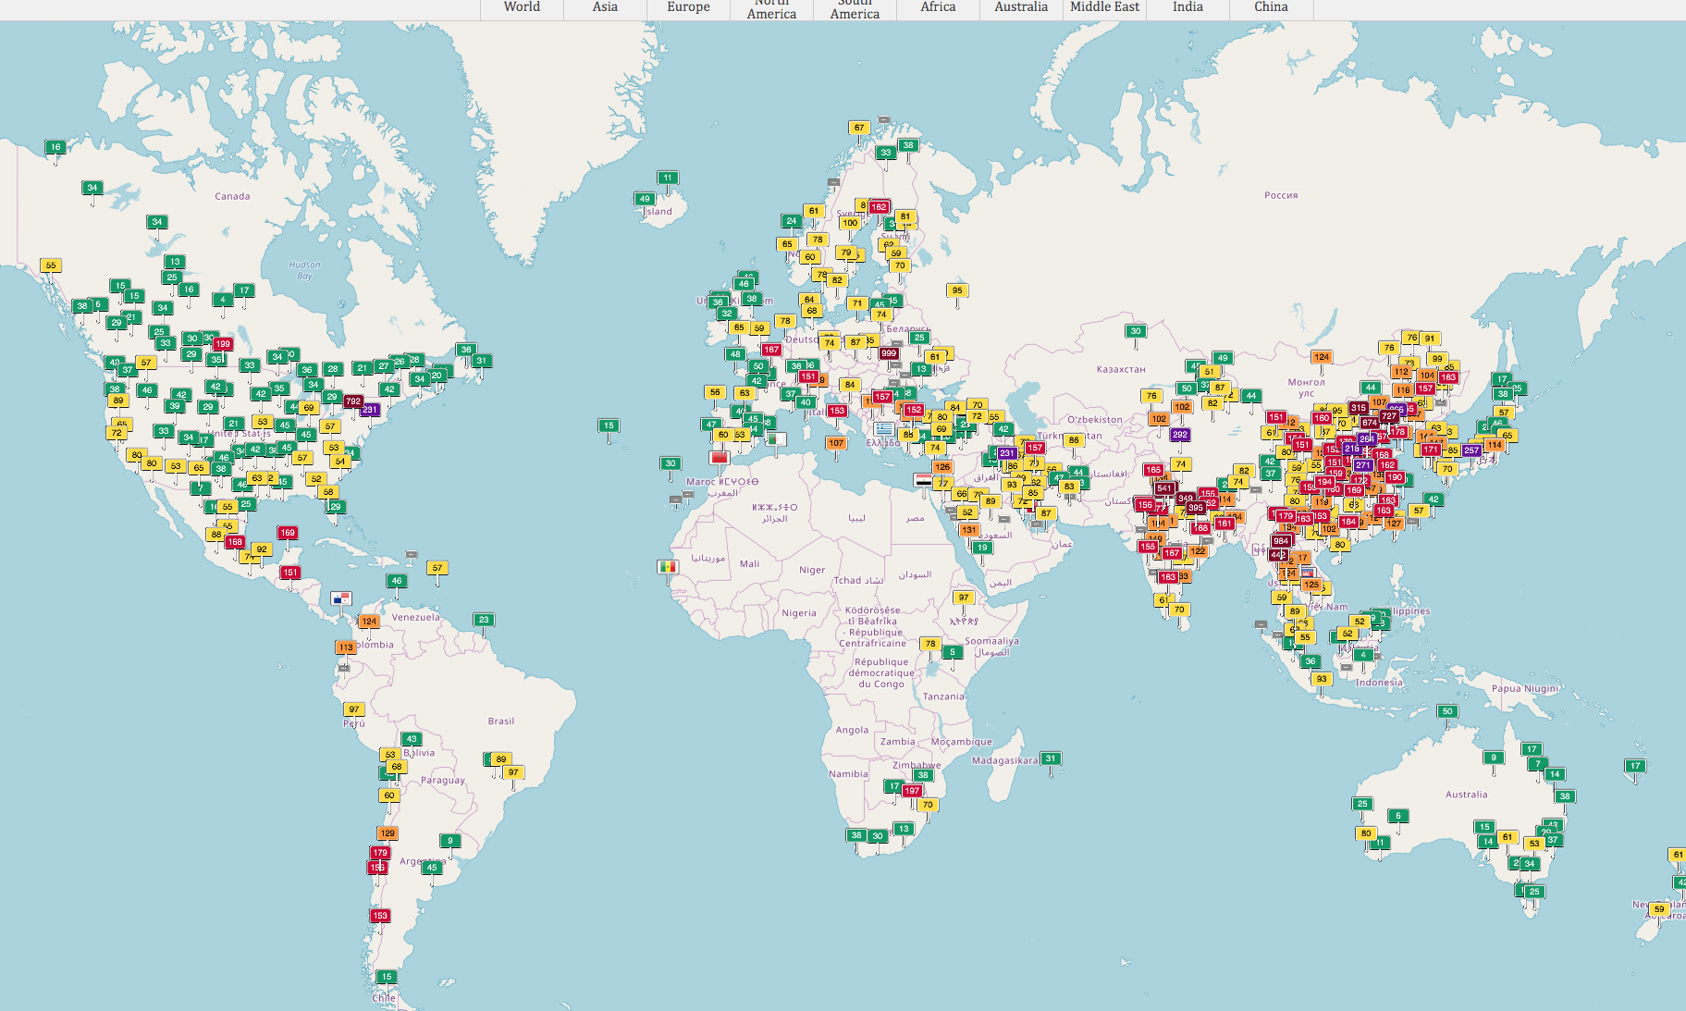
Severe shortage of air quality data
There is a severe shortage of data on air pollution in many low and middle-income countries
Source: http://aqicn.org (April 27, 2019)

Slide 11
